Slide 1
Kilmichael Wind Farm, Co. Wexford
SID Pre-Application Consultation Presentation
ACP SID Pre-App Ref. ACP-323955-25
12th March 2026

Slide 2





Applicant: Agent:
Kilgarvan Wind Farm Limited
Kilmichael Wind Farm Limited is a subsidiary of Regnum Renewables Developments Limited (Regnum Renewables), who are an Irish renewable energy company at the forefront of delivering new renewable technologies. Regnum Renewables have a number of Wind, Solar and BESS projects which are either currently in planning or moving forward to construction phase.
Fehily Timoney is an Irish Civil and Environmental Engineering, Scientific and Planning Consultancy. FT have been appointed by the applicant to prepare and coordinate the EIAR, in conjunction with a number of specialist consultants.

Slide 3
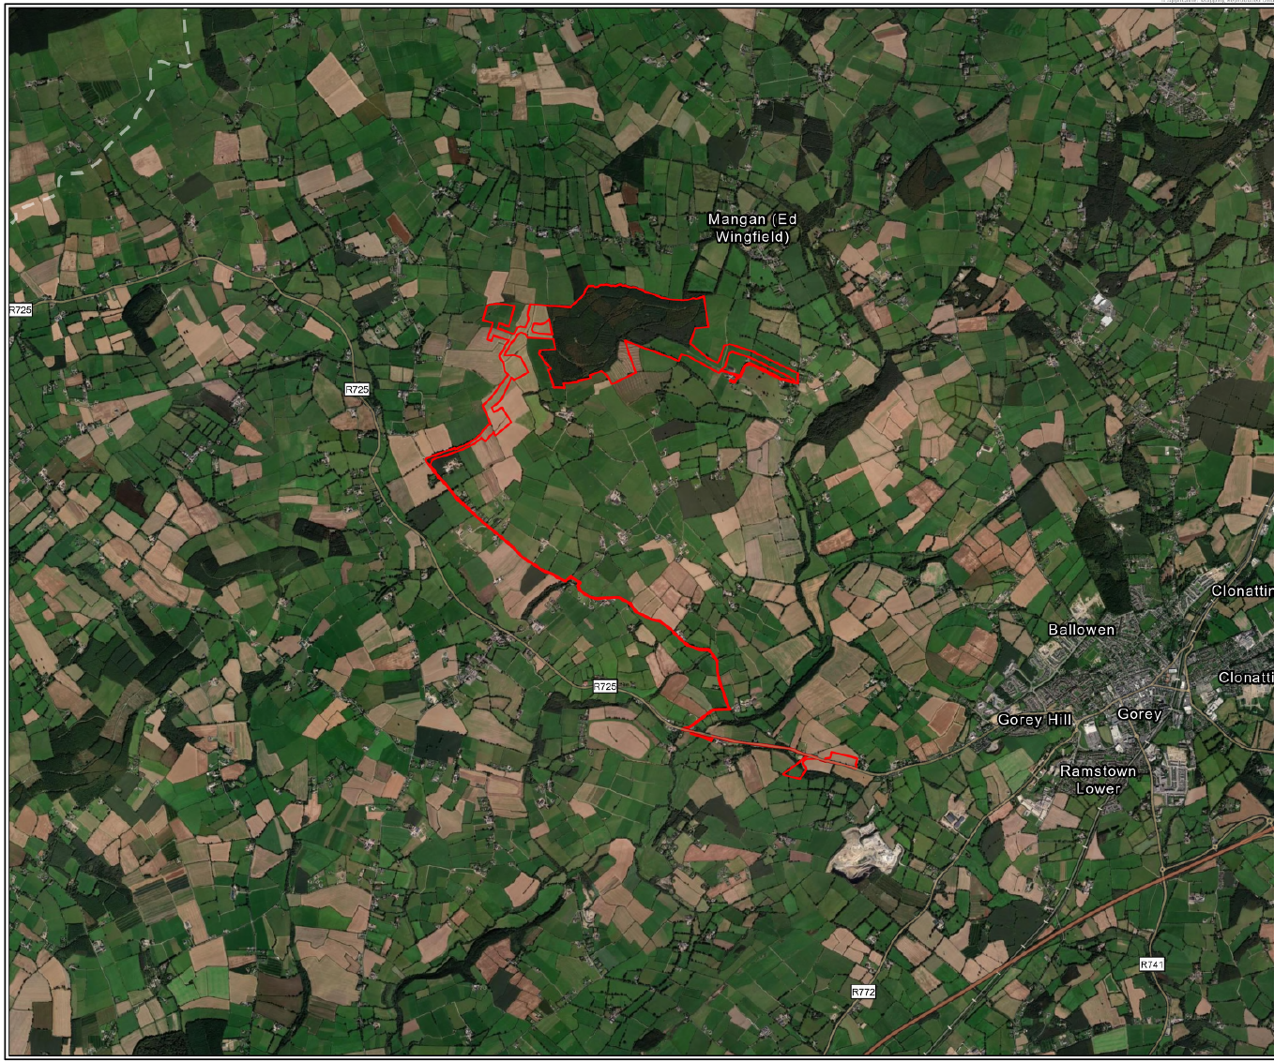
Site Location
The site is made up of a mix of private agricultural land and Coillte forestry.
The subject lands associated with the main wind farm site are located c. 5.5km to the northwest of Gorey, c. 7km west of Carnew, c.1.6km north east of Craanford, c.1.5km south east of Monaseed, and c.850m south west of Hollyfort.
The proposed substation and blade transition areas are located c.5km to the southeast of the main wind farm site, along the R725.
The surrounding landscape comprises mainly rolling farmland and forestry, and rural dwelling clusters.
A desktop planning history review has been undertaken, and no relevant planning applications fall within the red line boundary of the site.

Slide 4
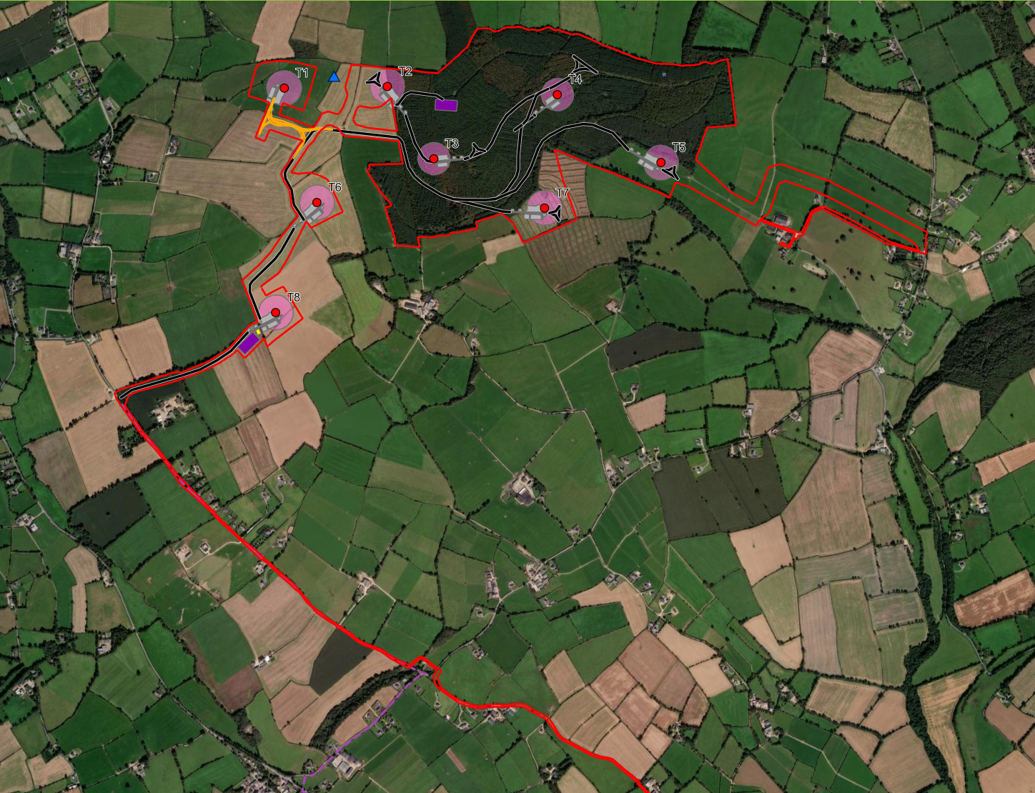
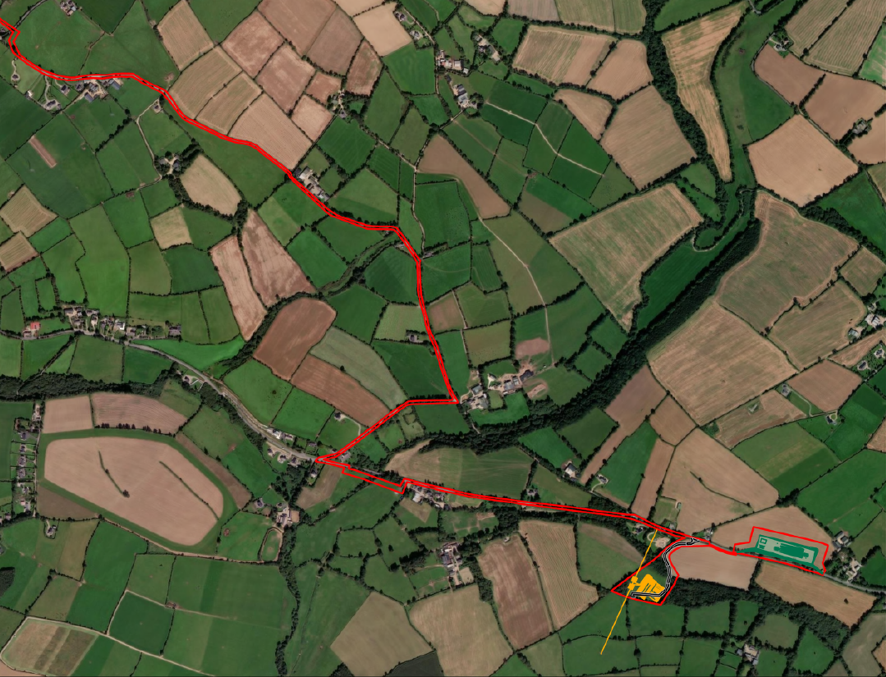
Proposed Site Layout
The Kilmichael Wind Farm development will comprise the following key elements:
  The main Wind Farm site will comprise 8 no. turbines, on-site Switch-house, access tracks, borrow pit and 2 no. temporary compounds
  Proposed off-site 110kV Substation and Control Room located approximately 5km south east of the wind farm site itself, to the south of the R725
  Associated 33kV grid connection cable route connecting the proposed wind farm site and proposed new off-site 110kV substation
  Blade transition laydown area to be located approximately 5km south east of wind farm site, to the north of the R725
  Accommodation works along proposed turbine delivery route (TDR) to facilitate turbine component delivery from Rosslare Port to the proposed Blade transition laydown area
  Relocation of an existing 32m telecoms mast within the Wind Farm site
  Proposed Met Mast to be located within the Wind Farm site
  Forestry Felling – undertaken by Keyhole felling

Slide 5
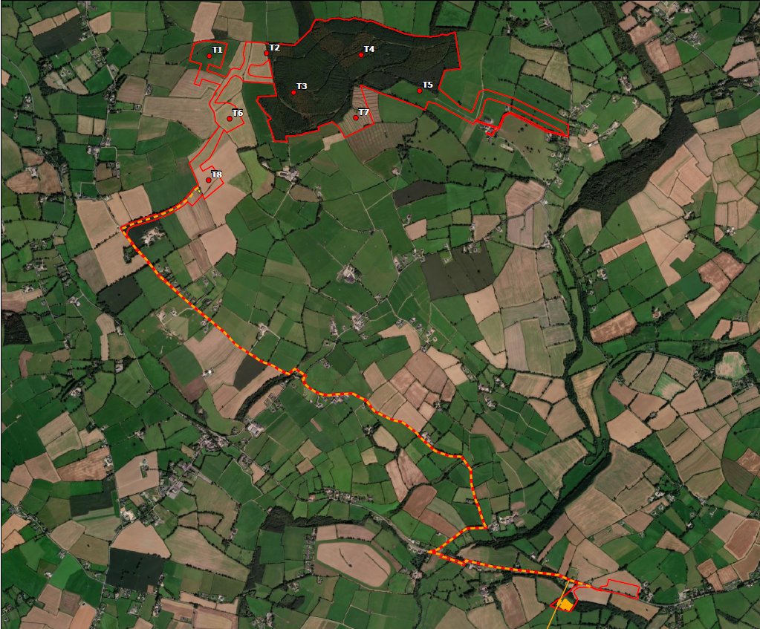
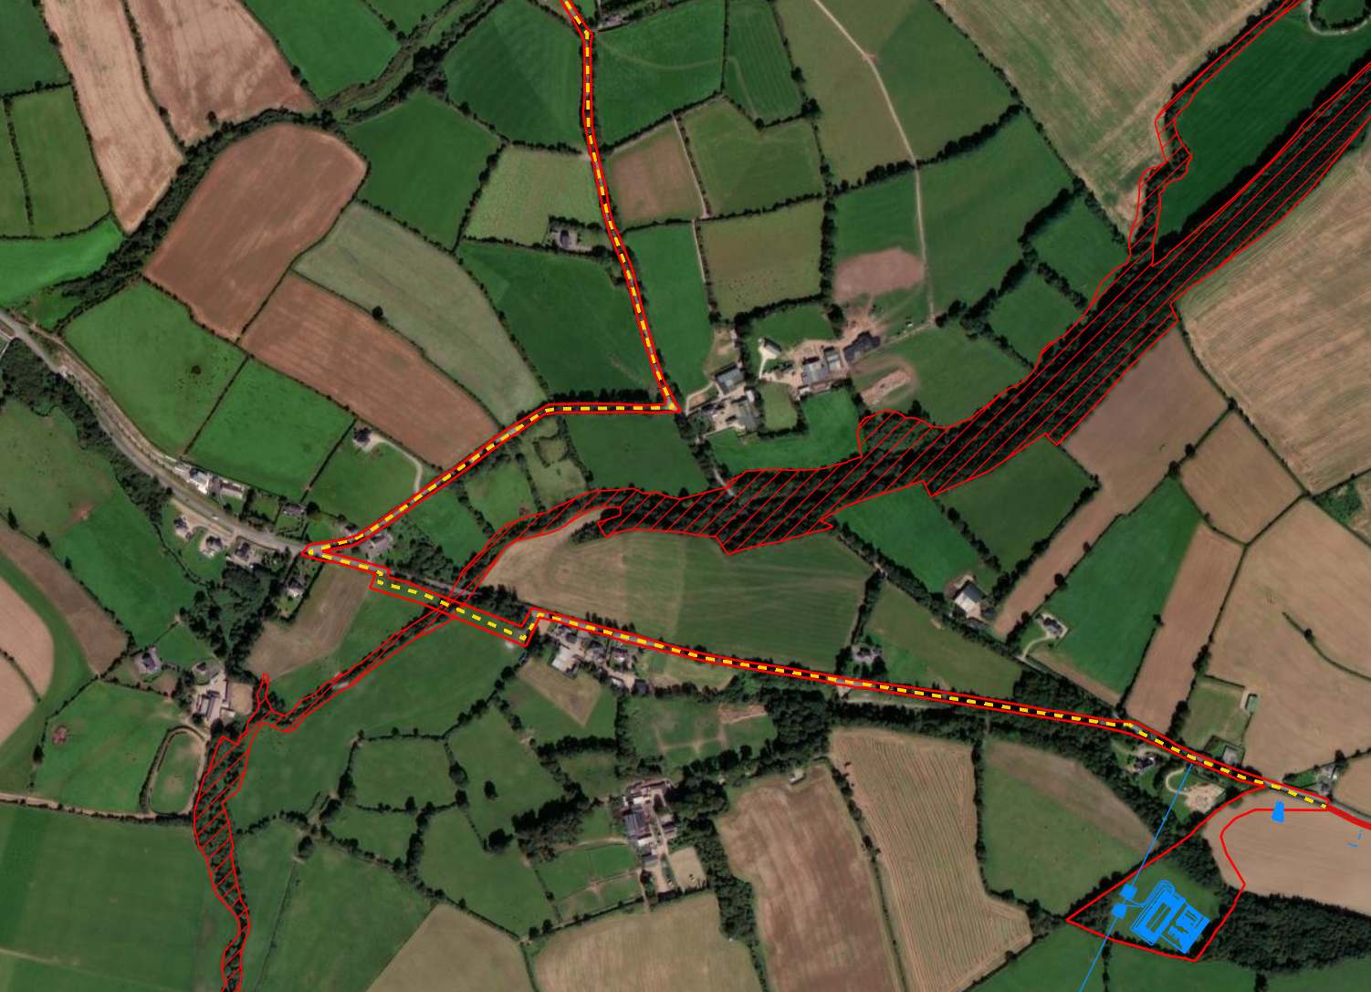
Proposed Grid
Connection Route – Option 1
Grid Connection Route Option 1 comprises a majority in-road option.
This option will run from the on-site switch house, exiting the site from the wind farm entrance and running along the local road L-5058-3, continuing along L-2028-2, then L-5058-1, taking a right onto L-5059-1, and a left onto regional road R-725-12, and finally onto R-725-13 where it reaches the proposed substation location.
The proposed GCR crossing of the Slaney River Valley SAC will be undertaken by HDD sufficiently setback from the riparian zone.
The new proposed substation is located adjacent to an existing overhead line which this scheme is proposing to connect into via a Loop-in connection.

Slide 6

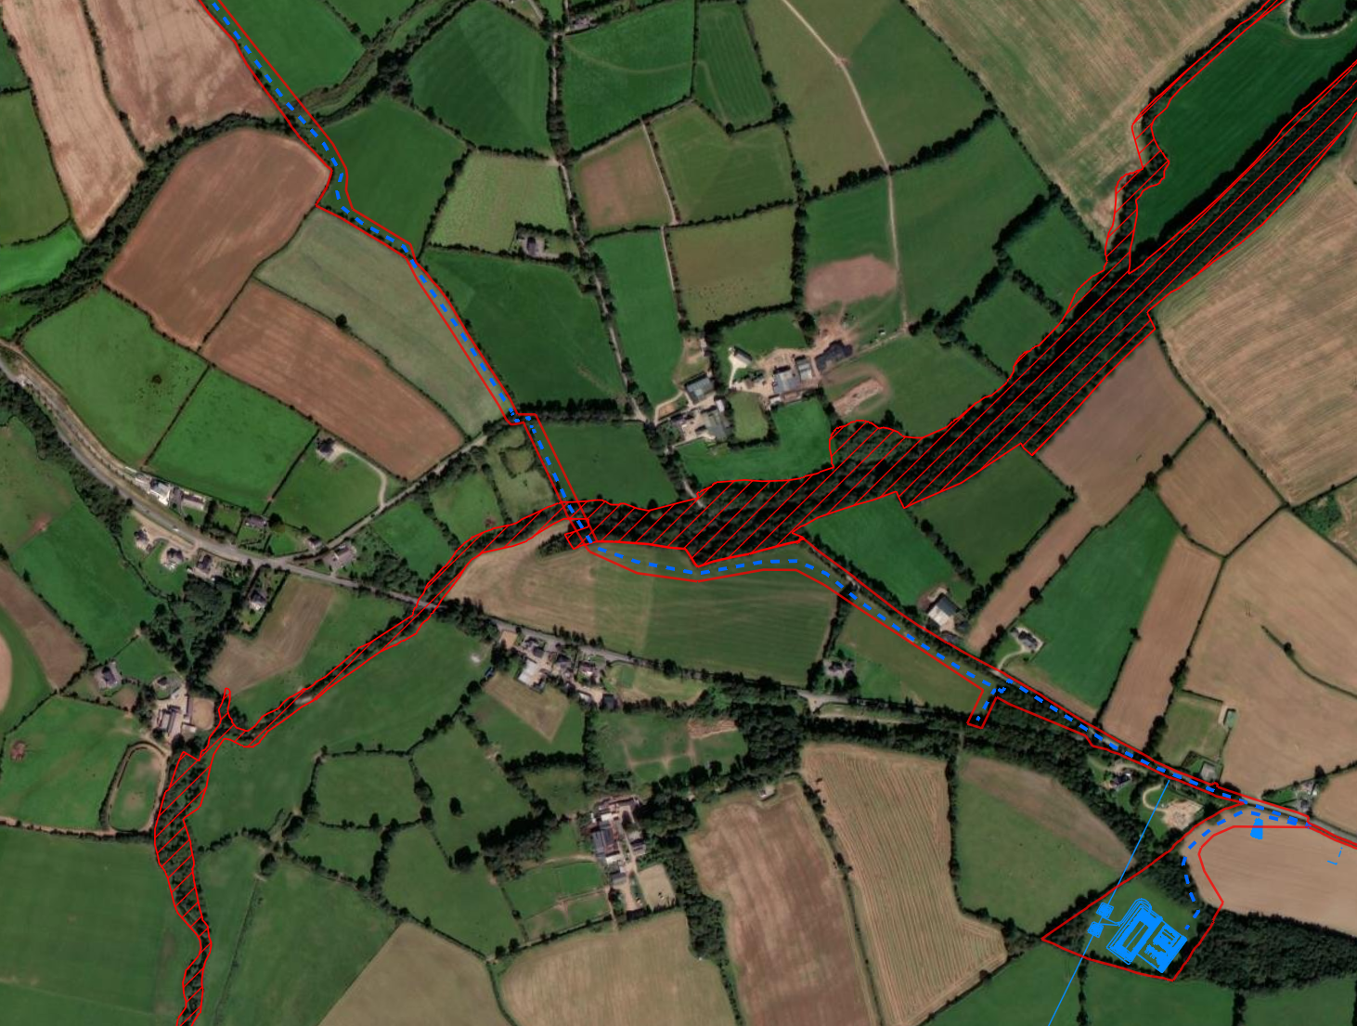
Proposed Grid
Connection Route – Option 2
Grid Connection Route Option 2 comprises a hybrid option which is part in-road and part off-road.
The applicant is currently in discussions with landowners for this part off-road option.
Seeking to reduce the quantum of works within the public road.
The proposed Grid Connection Route crossing of the Slaney River Valley SAC will be undertaken by HDD sufficiently setback from the riparian zone.

Slide 7
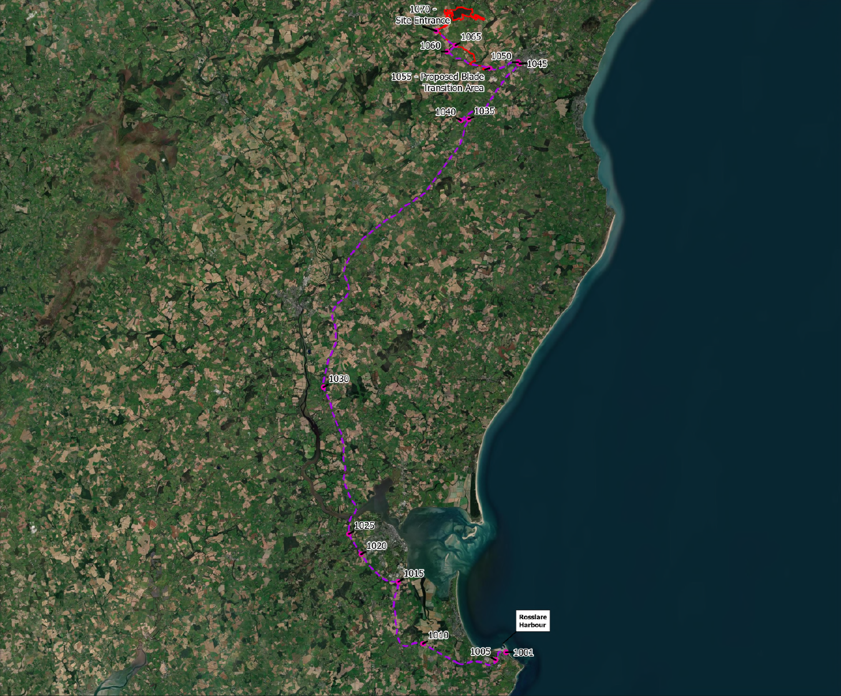
Proposed Turbine
Delivery Route
The identified Turbine Delivery Route (TDR) currently being considered from Rosslare Port will travel north along N25, onto the N11, turning right at Scurlocksbush Hill onto the M11, continuing along the M11 Enniscorthy Bypass, turning onto R772 towards south of Gorey, before turning left onto the R725 and travelling approx. 2.3km along R725 before entering the blade transition lands.
Accommodation works will be required along proposed turbine delivery route (TDR) to facilitate turbine component delivery from Rosslare Port to the proposed Blade transition laydown area. These works will be included within any subsequent planning application red line boundary.

Slide 8
Relevant Legislation
&
Local Planning policy Context

Slide 9
Legislation – 7th Schedule
Under Section 37B of the Planning and Development Act 2000 (as amended), a proposed development must firstly fall within a class specified in the Seventh Schedule. ‘Energy Infrastructure’ is specified in the Seventh Schedule of the 2006 Act (as amended) which includes:
“An installation for the harnessing of wind power for energy production (a wind farm) with more than 25 turbines or having a total output greater than 50 megawatts.”
The Proposed Development falls within the scope of Section 1 of the Seventh Schedule of the Strategic Infrastructure Act, 2006 (as amended), with the Proposed Development expected to provide an output of up to 57.6MW.
It is important to flag at this stage that the applicant is currently assessing a total of 4 no. turbine model types and intend to submit a separate Design Flex Pre-Application Request following the initial SID Pre-Application Meeting with ACP.

Slide 10


Key National Policy
The Climate Action Plan 2024 and Climate Action Plan 2025, which must be read together, state the following commitments:
  To achieve 80% renewable electricity by 2030;
  Deliver 9 GW of onshore wind by 2030;
  Hold at least one RESS auction per year;
  Prioritising and increase investment in the electricity grid; and
  Develop a policy to address repowering and extend the life of existing onshore wind farms
Project Ireland 2040: Comprising National Development Plan 2021 – 2030 (NDP), and the National Planning Framework (NPF).
These policy documents outlined the following key policies:
  NPO70: “Promote renewable energy use and generation at appropriate locations within the built and national environment to meet national objective towards achieving a climate neutral economy by 2050.”
  NPO71: “Support the development and upgrading of the national electricity grid infrastructure, including support the delivery of renewable electricity generating development.”
Renewable Energy Directive (RED) III: The recent transposition of the REDIII Directive into Irish Legislation has introduced statutory timelines on decision making in respect of renewable energy developments. This highlights the governments continued commitment to delivering further renewable energy development, achieving the statutory targets outlined above, and actively fighting against climate change.
In summary, the Proposed Development represents a strengthening of the national transmission network to facilitate renewable energy that will materially contribute to national energy targets and assist in the achievement of objectives of the National Planning Framework and the RSES.

Slide 11
Renewable Energy Directive III (RED III) – Formal EIA Scoping
Regulations 6, 12, 14 and 18 of S.I. 274 of 2025, made amendments to the EIA scoping provisions of the 2000 Act in order to transpose article 16b(2) of RED III, which requires that EIA scoping is mandatory for renewable energy projects that fall within the provisions of article 16b of the Directive. Mandatory Scoping is required from 1st May 2026.
Subject to Environmental Impact Assessment:
  Population and Human Health
  Land, soils and Geology
  Hydrology and Water Quality
  Biodiversity
  Ornithology
  Traffic and Transportation
  Noise and Vibration
  Shadow Flicker
  Landscape and Visual
  Archaeology, Architectural and Cultural Heritage
  Air Quality and Climate
  Material Assets, Telecoms and Aviation
Appropriate Assessment (AA) Screening Report and Natura Impact Statement (NIS) will be submitted as part of any subsequent planning application on these lands.

Slide 12
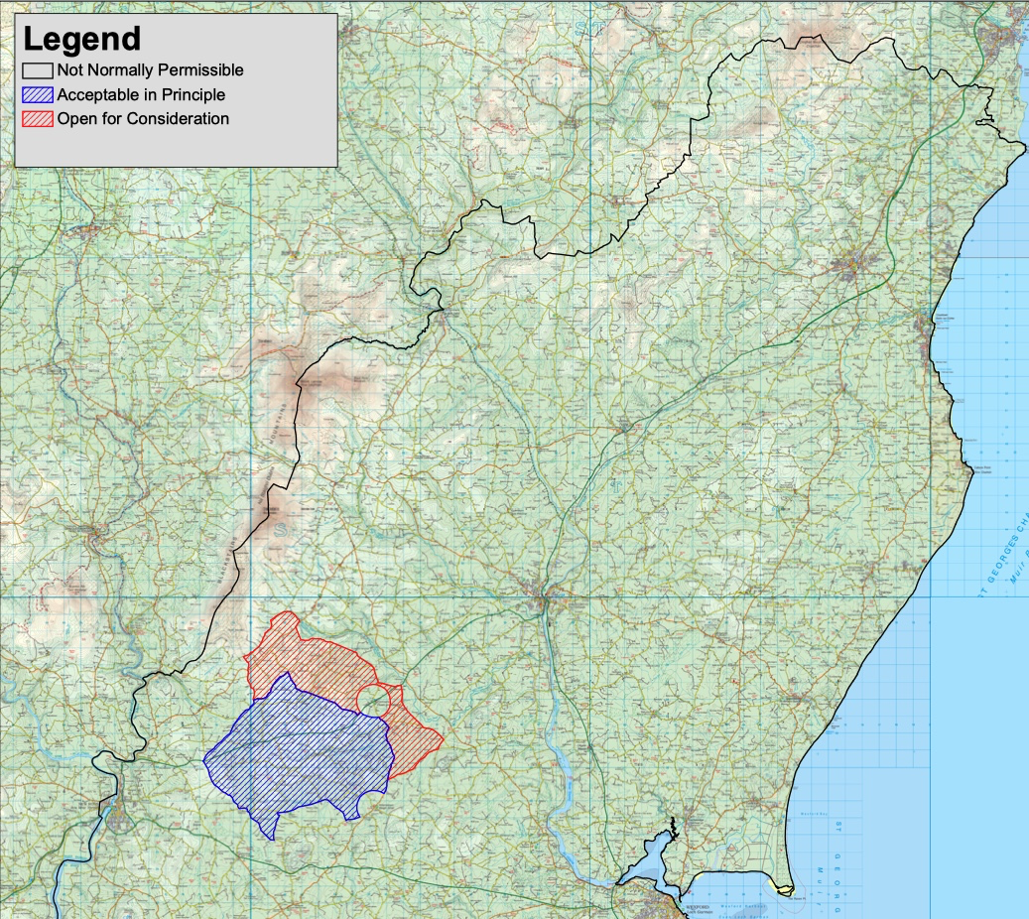
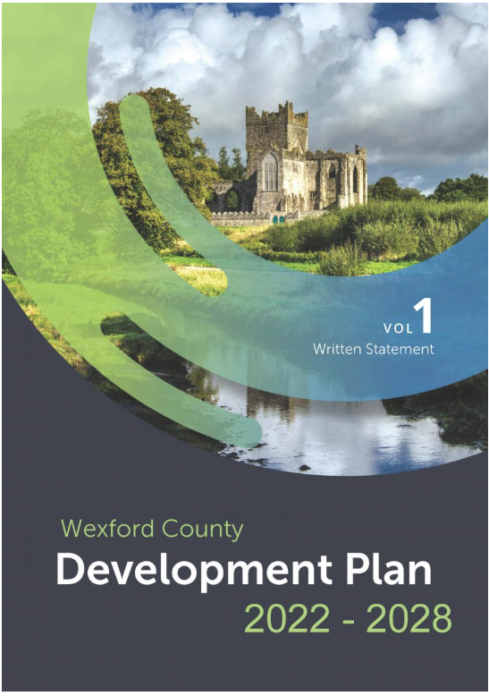
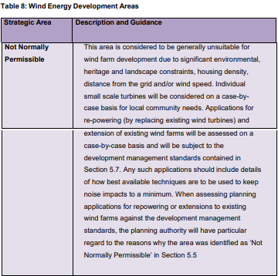
Local Planning Policy
The Wexford County Development Plan 2022-2028 (CDP) came into effect on 25th July 2022.
The ‘Energy Strategy’ (Volume 10 of the CDP) identifies the site within an area classified as “Not Normally Permissible” for wind development. It is important to note that the policy “Not Normally Permissible” for wind energy development does not expressly preclude wind energy in this area, but would generally discourage same.
SITE
Extract of Map 14 - Wind Energy Strategy Map (Vol 10 - Energy Strategy of the Wexford CDP)

Slide 13
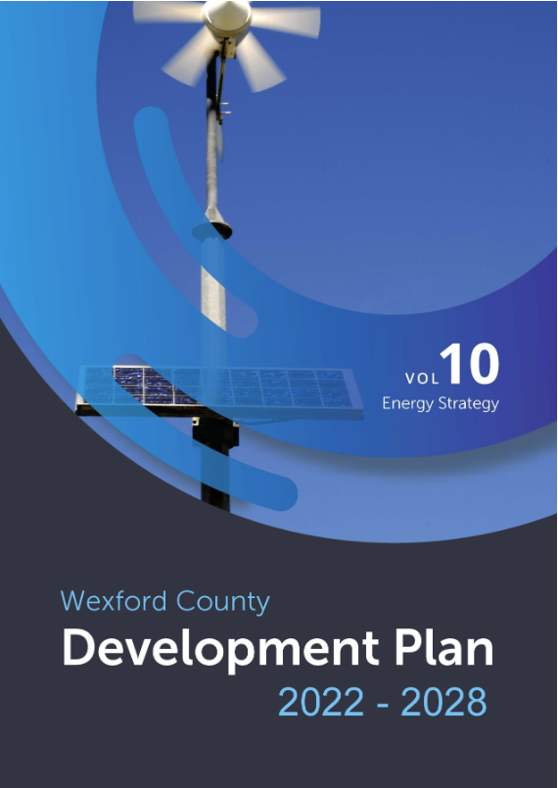
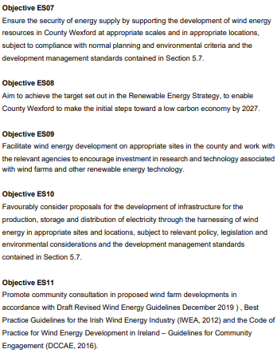
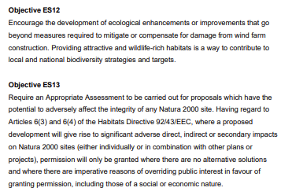
Local Planning Policy
A number of Wind Energy development objectives are included at Section 5.6 of Volume 10 (Energy Strategy) of the CDP. The most relevant objectives to this proposal are listed on this slide.

Slide 14
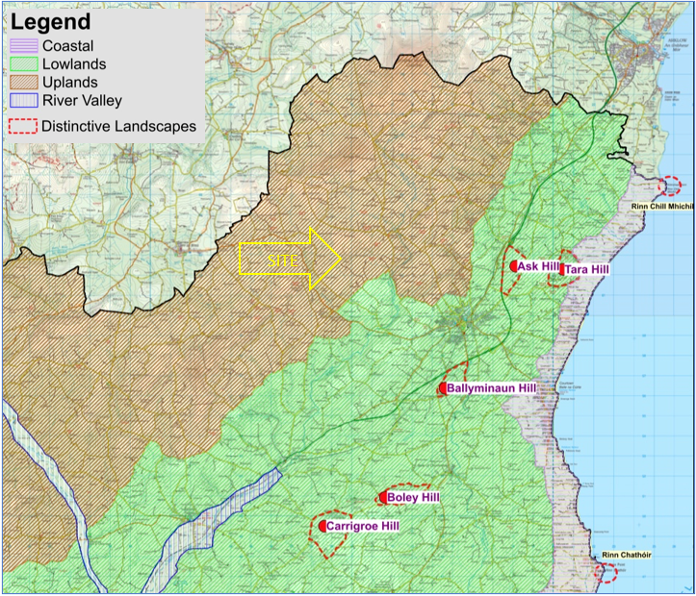
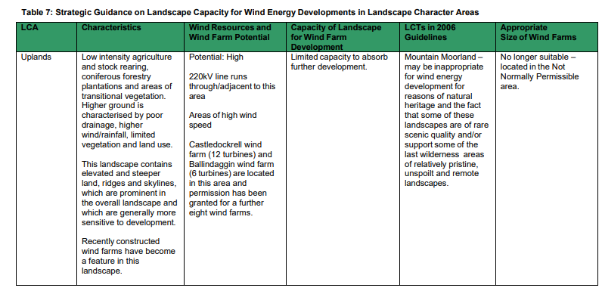
Local Planning Policy - Landscape Character Assessment
The landscape classification of the site is an ‘Uplands’ designation which is described as;
“The Uplands is mainly characterised by areas of higher ground, with some variations within, and relates to the north and west of the county. The higher ground has more rainfall, wind and poor drainage with a limited range of vegetation and land use. At the higher reaches, agriculture is generally low intensity with stock rearing, forestry plantations and some areas of transitional vegetation. Afforestation may become a more dominant land use in these areas in the future.
On lower ground, fields are larger with low hedges and scattered smaller trees. The land is mostly used for stock rearing or mixed agricultural use. Some coniferous forestry, deciduous forestry and transitional woodland on steep slopes can be found within these areas. Recently constructed wind farms have become a feature in this landscape.
This landscape contains elevated and steeper land, ridges and skylines, which are prominent in the overall landscape, and which are generally more sensitive to development. Whilst having lower population densities than the lowland landscapes, the Upland LCU does accommodate significant living and working populations whose needs must be accommodated.”
The ‘Uplands’ designation has been assigned a ‘High’ landscape sensitivity rating in the CDP.

Slide 15
SITE CONSTRAINTS

Slide 16
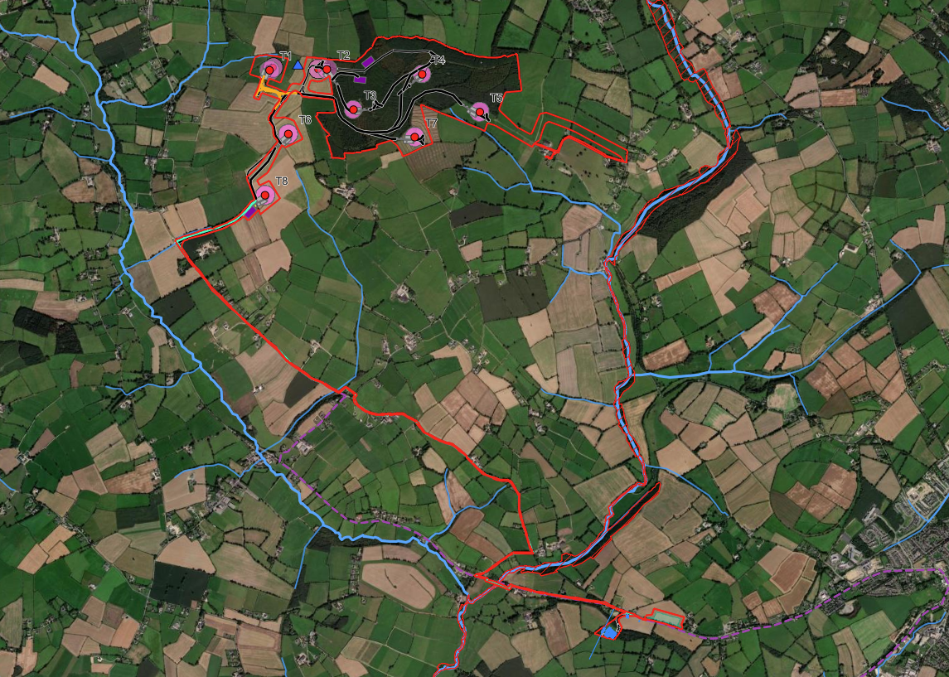
Environmental Designations
The Wind Farm site does not fall within any European or National protected areas. The Grid Connection Route will cross the Slaney River Valley SAC.
Slaney River Valley SAC is located approx. 1.5km to the east of the main wind farm. It has been flagged that a qualifying interest of the SAC is Freshwater Pearl Mussel.
Site is hydrologically connected to the Slaney River Valley SAC.
The proposed Grid Connection Route crossing (for both Option 1 & 2) of the Slaney River Valley SAC will be undertaken by HDD sufficiently setback from the riparian zone.

Slide 17
Ecological Survey Overview
Ecological and ornithological surveys have been ongoing since April 2023, which have informed the current site design.
Surveys:
    Wintering Birds
    Breeding Birds
    Bat Surveys
    Terrestrial Habitats
    FWPM
    Fauna
    Mammal Surveys
    Aquatic Ecology
    Invasive Species
Assessment of European Designated Sites
  AA Screening
  Natura Impact Statement
Assessment of National Designated Sites

Slide 18
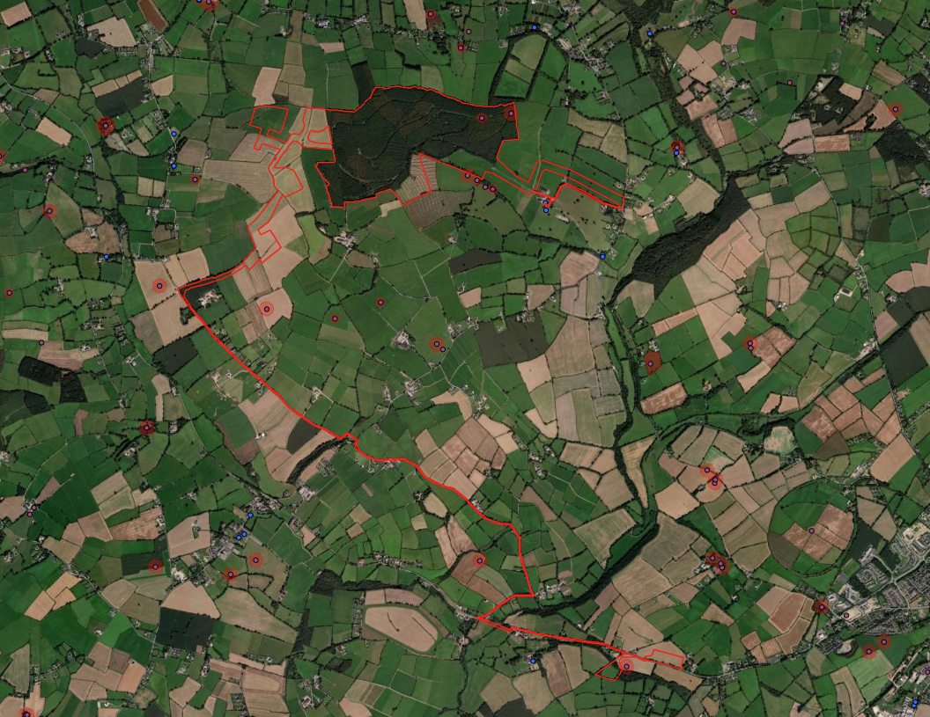
Archaeological Context
There are 2 no. recorded ringfort sites located within the eastern portion of the Wind Farm site within Coillte forestry. None of the turbines are currently proposed within 300m of these locations.
There is a 1 no. recorded ringfort within 60m of the proposed substation site, with the ringfort ZON extending within 10m of the substation site boundary.
2 no. NIAH assets within 800m to east of T5 – Mount Saint Benedict County House, and Mount Saint Benedict Farmyard.

Slide 19
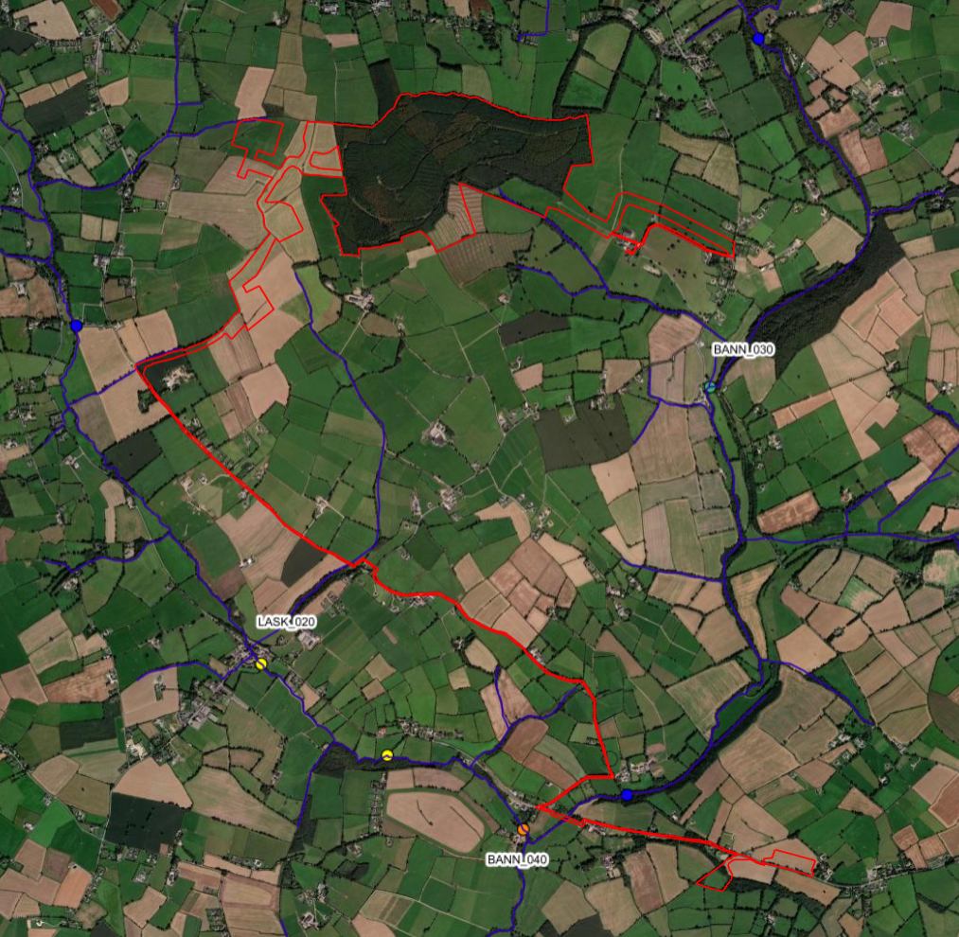
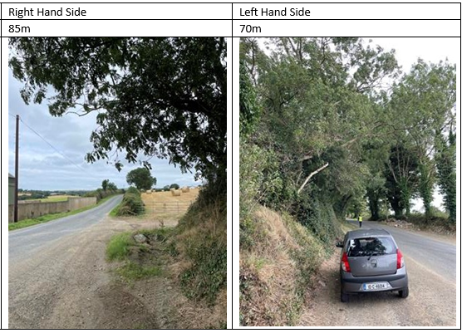
Civil and Hydrology Site Walkover
Site Walkover surveys to date were undertaken by FT Engineers on 8th August 2025, and 6th January 2026.​
The surveys so far have focused on the existing site conditions, including identification of streams, drains, and overland flow paths intersecting or running adjacent to the proposed works. Any significant topographical constraints have also been recorded.​
All watercourse crossings and drainage features are mapped to inform the design. No notable hydrological issues have been identified beyond those addressed through standard mitigation measures.​ The site does not fall within any flood zones.
In accordance with Wexford County Council’s Development Plan requirements for access design (Section 6.2.6, Volume 2), the proposed access points to the main wind farm site and substation lands will achieve the required sightlines in both directions.
For example – the main Wind Farm site is to be accessed from a Local Road therefore requiring sightlines of 65m in either direction.

Slide 20
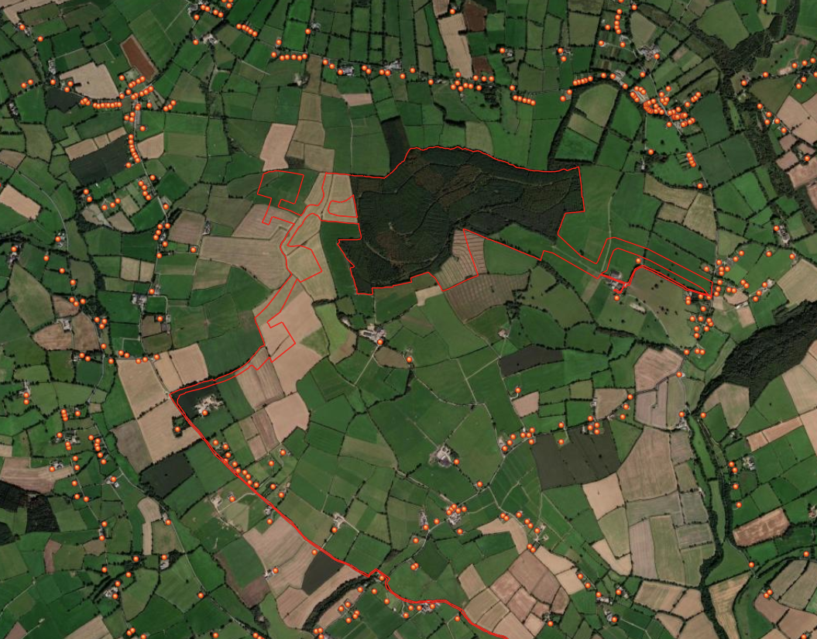
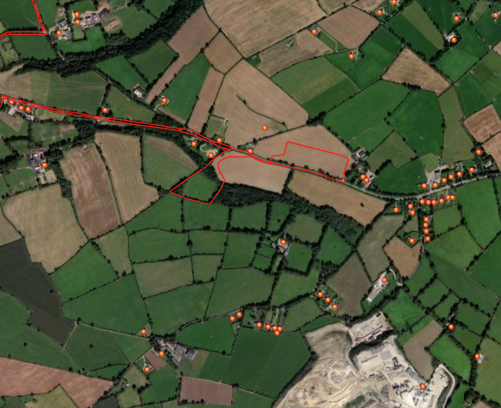
Residential Receptors
Wind Farm Site – There are no residential receptors located within 728m of any turbine (4 times tip height = 728m)
Substation Lands – Approximately 23 no. receptors within 500m of the site, and 6 no. receptors within 250m of the site.

Slide 21
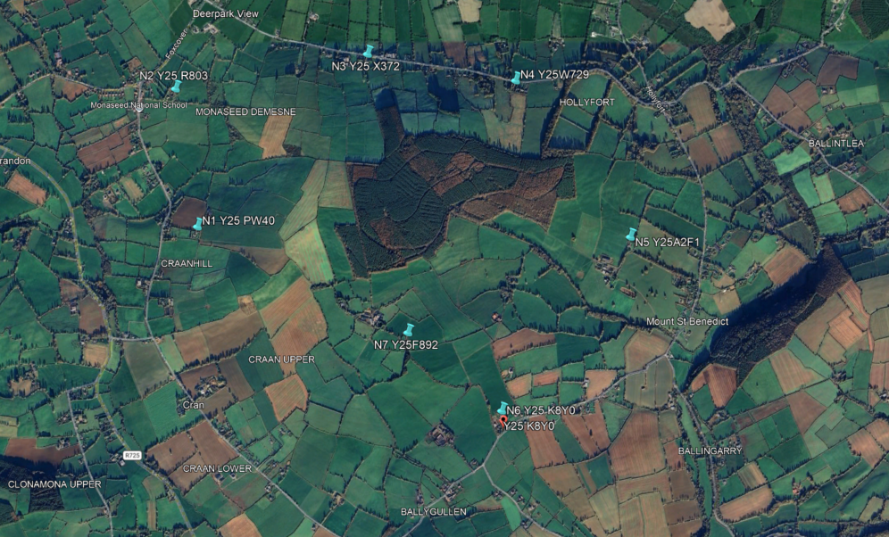
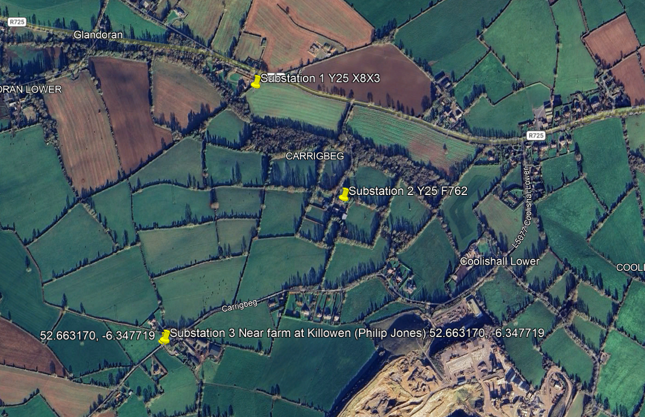
Noise Surveys
Noise surveys were undertaken between 12th August 2025 – 13th August 2025 at 3 no. locations within vicinity of substation site, and between 16th October 2025 - 13th November 2025 at 7 no. locations within the vicinity of proposed Kilmichael Wind Farm.
The noise data collected adjacent to the substation lands will be assessed against EPA NG4 criteria, and a BS4142 type assessment.
For the Wind Farm site, the Wind Energy Development Guidelines 2006 specify for daytime noise limit a lower fixed limit of 45 dB(A),“in low noise environments where background noise is less than 30 dB(A), it is recommended that the daytime level of the LA90, 10min of the wind energy development noise be limited to an absolute level within the range of 35-40 dB(A)……… A fixed limit of 43dB(A) will protect sleep inside properties during the night.”
From a preliminary review of the data, it indicates that a good range of windspeeds and adequate noise data has been captured. The survey indicates that a low noise environment (<30 dB L_{A90}) occurred at up to 4m/s an 7m/s, so the lower limit could apply at certain locations up to 7m/s.
The next stage will be to model the proposed turbine to examine for any exceedance.

Slide 22
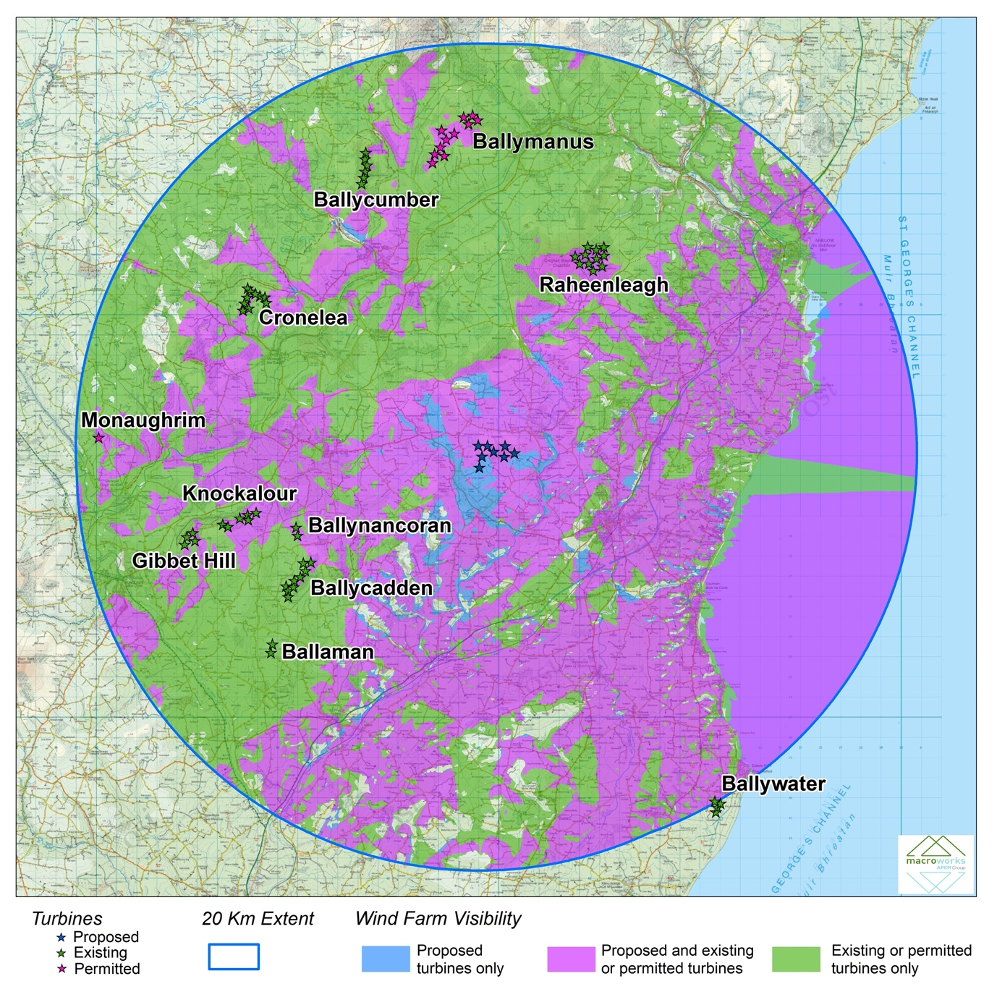
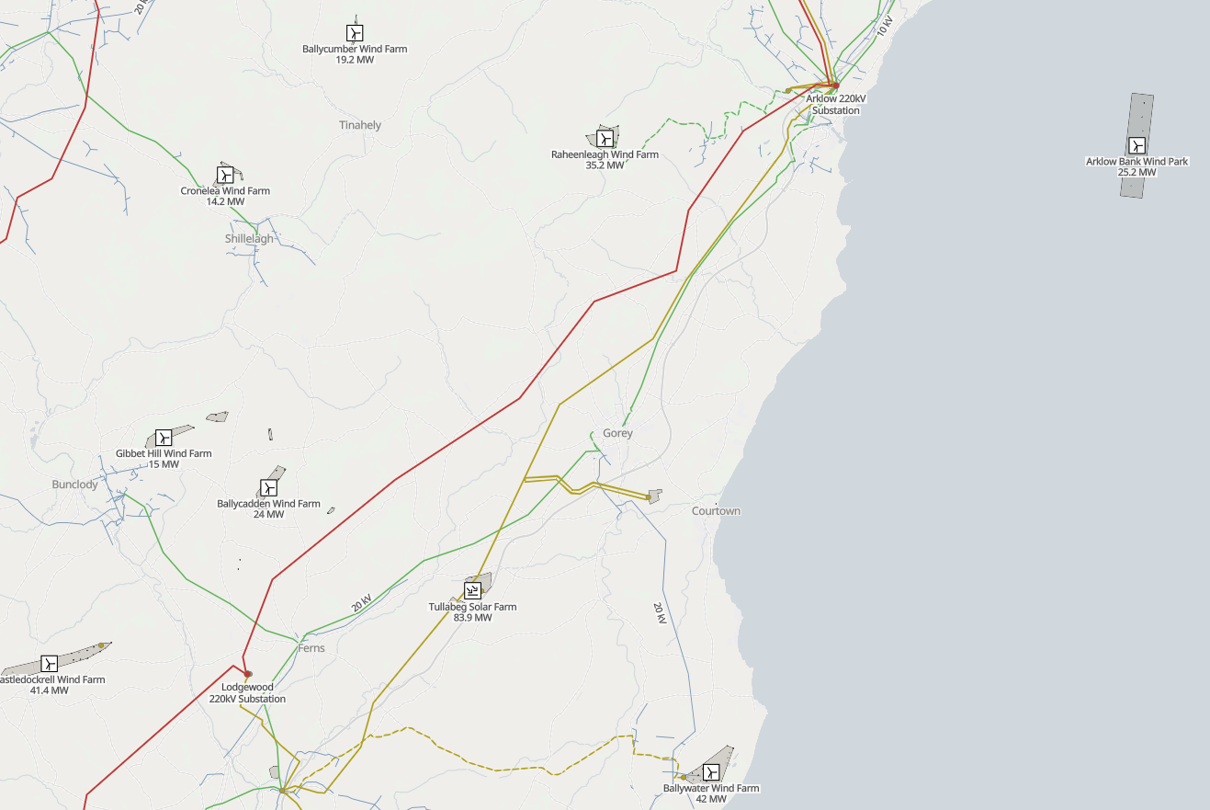
Existing Infrastructure
This map illustrates the locations of existing wind farm developments within the surrounding context, including existing overhead powerline infrastructure within the area:
    110kV overhead powerlines (gold)
    220kV powerline (red)
    38kV powerlines (green)
The lands fall within an accessible location with regards to existing infrastructure.
There are 11 no. onshore wind energy developments (9 no. existing and 2 no. permitted) within the 20km study area, but none within 10km of the proposed development site. These tend to be of small and medium scale in terms of both turbine height and number/extent. Except for the 21 no. turbine Ballywater scheme located on the Wexford Coastline, approx. 20km to the southeast of the site.
Overall, it is considered that the proposed wind farm has very little potential to contribute to significant cumulative impacts in combination with existing or permitted wind farms within the study area.
SITE
SITE

Slide 23
Consultation

Slide 24
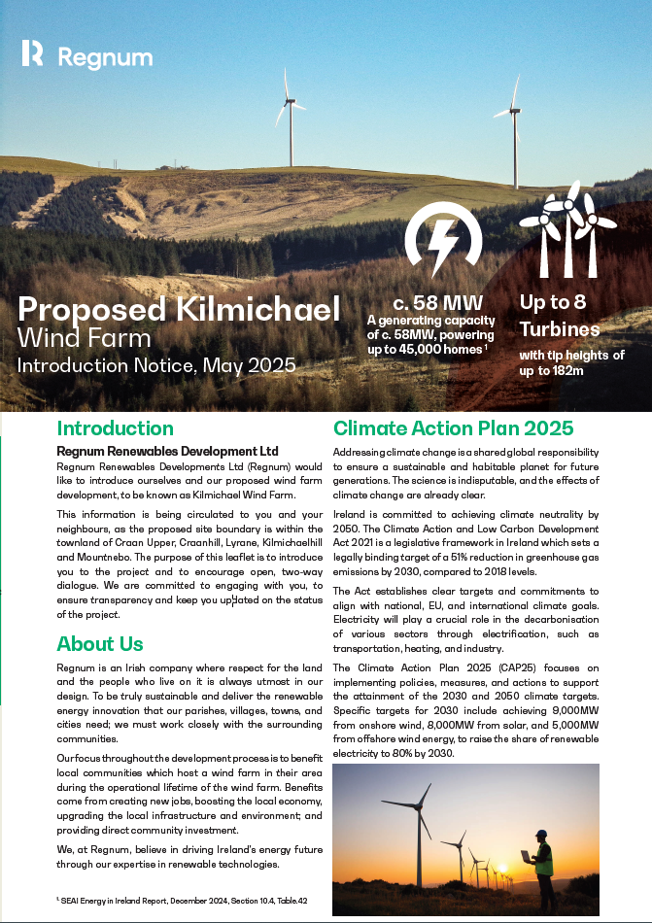
Consultation
Community Engagement:
Regnum appointed a local community liaison officer in Spring 2024
Regnum engaged with the local councillors in the summer of 2024, outlining the proposed community consultation strategy
Phase 1 - Door to Door Engagement in Q2 2025
Regnum engaged with the local TDs in Q3 2025
Phase 2 - Door to Door Engagement in Q1 2026
Phase 3 – A third and final round of Door-to-Door Engagement is scheduled for Q3 2026
Wexford County Council (WCC) Consultation:
Regnum undertook a meeting with WCC Officials in September 2024, and outlined the proposal and engagement strategy for the project.

Slide 25
Next Steps

Slide 26
Proposed Timelines and Next Steps
    Submission of the planning application is targeted for September 2026
    Agreement of minutes from today
    Can ACP provide any timeframe predictions around the Formal EIA Scoping process coming into effect from 1st May 2026?
    At this stage, do ACP foresee any implications from the next phase of commencements of the Planning and Development Act 2024?

Slide 27
Thank You

